Slide 1
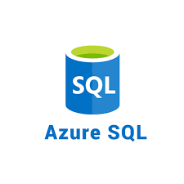




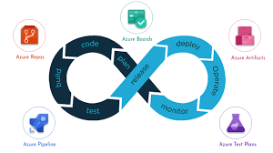
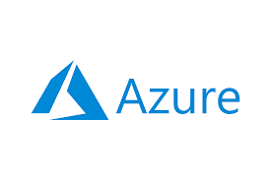
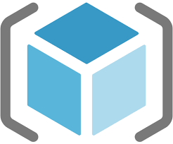
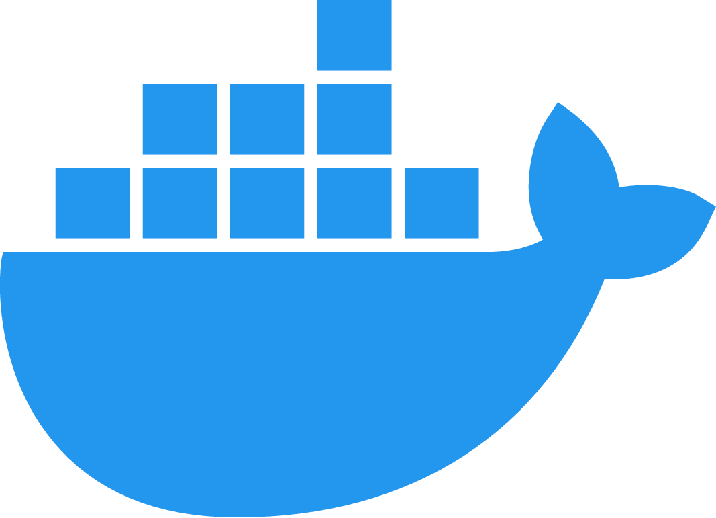

Azure Compute Services

Slide 2

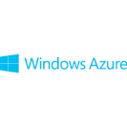
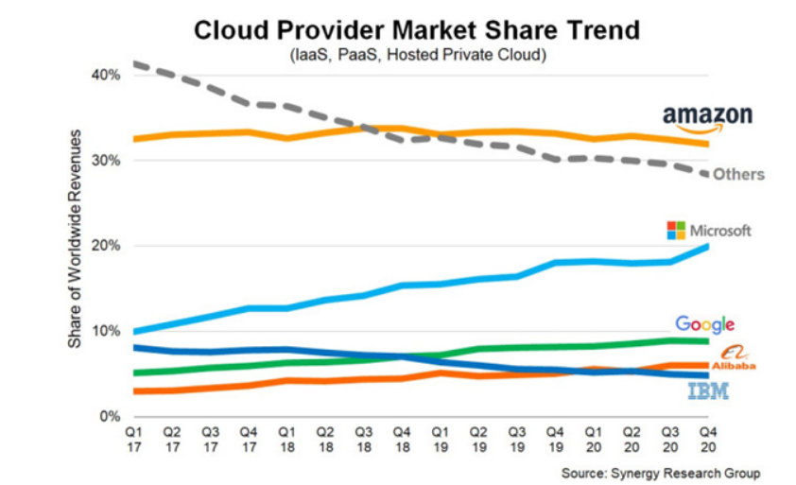
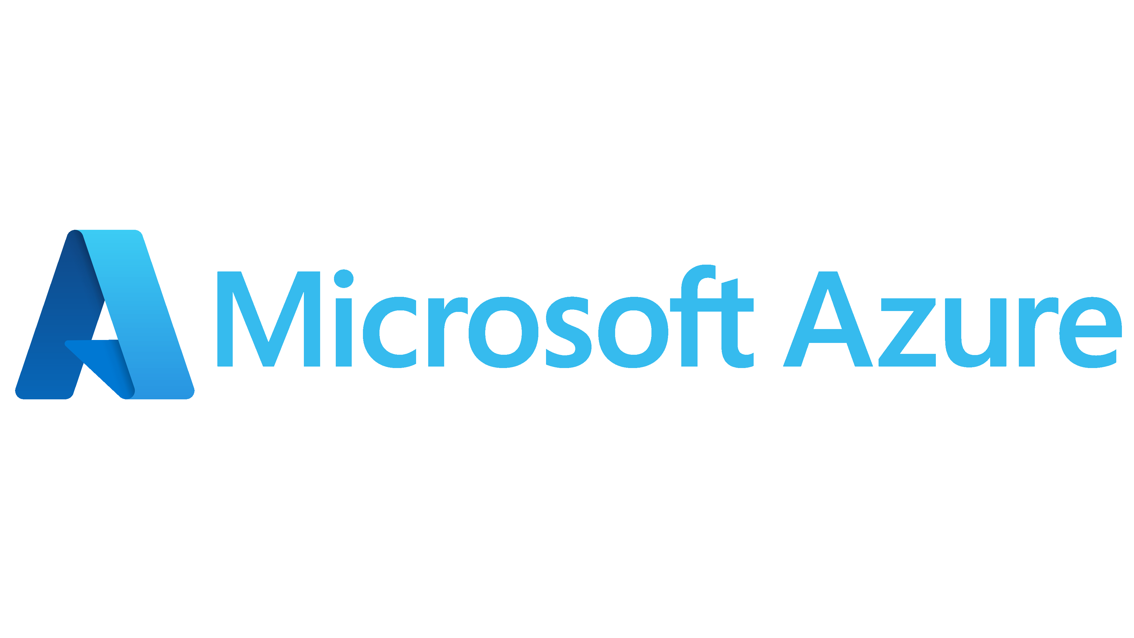
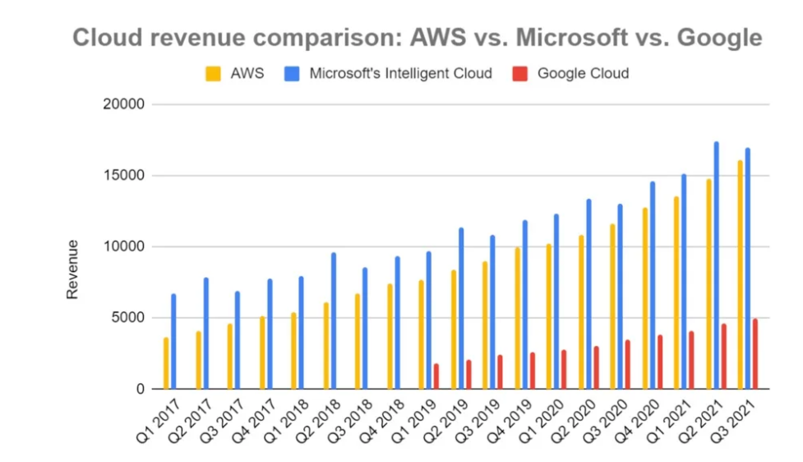
Azure Cloud Services
Why Microsoft Azure?
Launched in 2010 as
Renamed in 2014 as
URL For azure cloud -- https://portal.azure.com
Azure Regions - https://azure.microsoft.com/en-us/global-infrastructure/geographies/#geographies

Slide 3
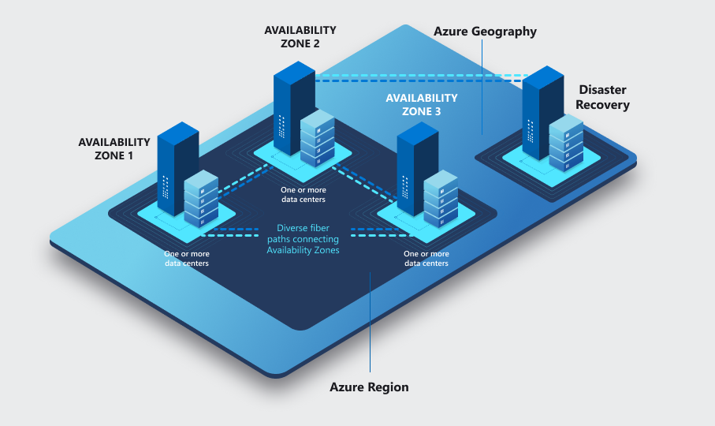

Azure Cloud Services
Azure cloud Key terms
Subscription- an agreement between organization and Microsoft to use resources.
Resource Groups- a logical container that holds related resources for an Azure solution
Regions- a set of datacentres deployed within an interval-defined perimeter and
connected through a dedicated regional low-latency network
Availability Zones- connected by a high-performance network
with a round-trip latency of less than 2ms
Azure Resource Manager- is the deployment and management service for Azure.
It provides a management layer that enables you to create, update, and delete resources in your Azure account
Azure CLI- a cross-platform command-line tool to connect to Azure and execute administrative commands on Azure resources
Cloud Shell- is an interactive, authenticated, browser-accessible shell for managing Azure resources
Tags- to your Azure resources, resource groups, and subscriptions to logically organize them by values that make sense for your organization

Slide 4



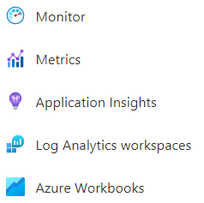
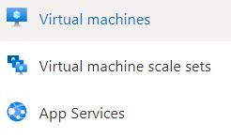


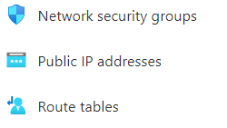



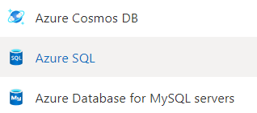

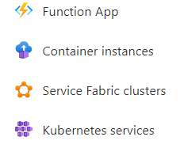

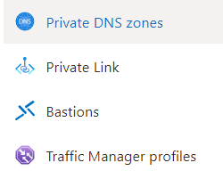





Azure Cloud Services
List Of Services

Slide 5
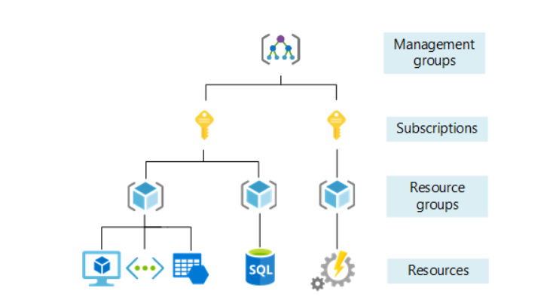
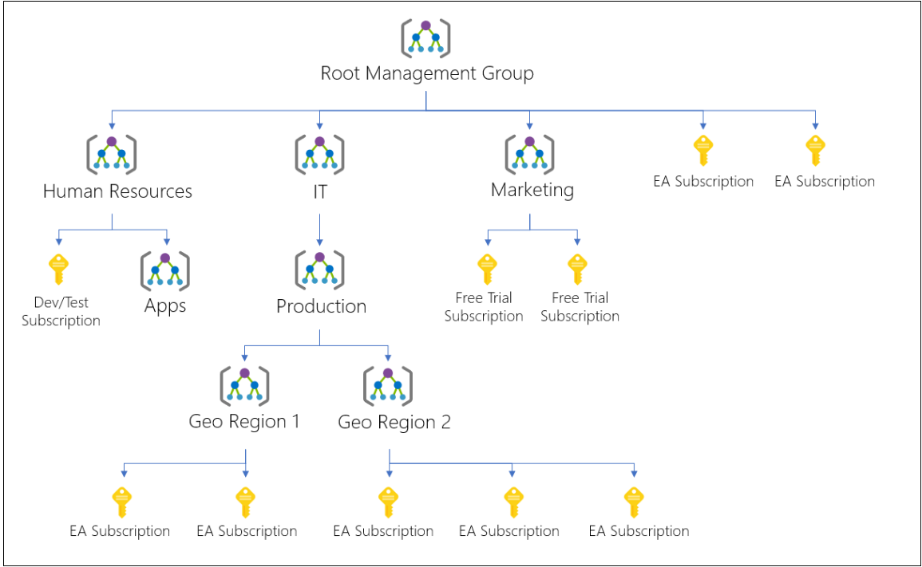
Azure Cloud Services
Hierarchy of Azure Resources

Slide 6
Azure Cloud Services
Tools for Deploying Azure Resources
Azure Portal – Graphical Interface which can accessible from browser or we can install azure desktop app
Cloud Shell - interactive, authenticated, browser-accessible shell. Either Bash or PowerShell commands
Azure CLI - set of commands used to create and manage Azure resources.
Azure PowerShell - a set of cmdlets for managing Azure resources directly from PowerShell
ARM Templates – JSON files that declare azure resources and deploy them to Azure cloud
Terraform – Open source tool used as Infrastructure as a Code to build, change and destroy the infrastructure

Slide 7
Azure Cloud Services
ARM Templates
ARM Templates are JSON files, to declare the objects you want, the types, names and properties and can be checked into source control and managed like any other code file
ARM Templates Schema
{
"$schema": "https://schema.management.azure.com/schemas/2019-04-01/deploymentTemplate.json#",
"contentVersion": "1.0.0.0",
"parameters": {},
"functions": [],
"variables": {},
"resources": [],
"outputs": {}
}
https://docs.microsoft.com/en-us/azure/azure-resource-manager/templates/template-tutorial-create-first-template?tabs=azure-cli

Slide 8
Azure Cloud Services
ARM Templates deployment methods
Incremental - In incremental mode, Resource Manager leaves unchanged resources that exist in the resource group but aren't specified in the template. Resources in the template are added to the resource group. It is Default method
Complete - In complete mode, Resource Manager deletes resources that exist in the resource group but aren't specified in the template.
az deployment group create --mode Complete or incremental
--name ExampleDeployment --resource-group ExampleResourceGroup --template-file storage.json
ARM Templates deployment Scope
Resource Group
Subscription
Management Group
Tenant

Slide 9
Azure Cloud Services
ARM Templates deployment Scope
Resource Group
{
"$schema": "https://schema.management.azure.com/schemas/2019-04-01/deploymentTemplate.json#",
"contentVersion": "1.0.0.0",
"resources": []
}
Az cli command: az deployment group create –template-file <path to template file>
Subscription
{
"$schema": "https://schema.management.azure.com/schemas/2018-05-01/subscriptionDeploymentTemplate.json#",
"contentVersion": "1.0.0.0",
"resources": []
}
Az cli command: az deployment sub create –template-file <path to template file>

Slide 10
Azure Cloud Services
ARM Templates deployment Scope
Management Group
{
"$schema": "https://schema.management.azure.com/schemas/2019-08-01/managementGroupDeploymentTemplate.json#",
"contentVersion": "1.0.0.0",
"resources": []
}
Az cli command: az deployment mg create –template-file <path to template file>
Tenant
{
"$schema": "https://schema.management.azure.com/schemas/2019-08-01/tenantDeploymentTemplate.json#",
"contentVersion": "1.0.0.0",
"resources": []
}
Az cli command: az deployment tenant create –template-file <path to template file>

Slide 11
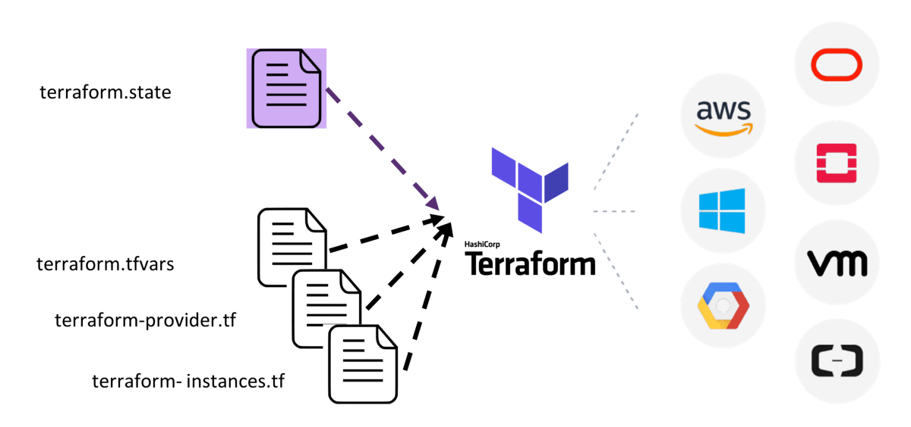

Terraform
Terraform is an infrastructure as code tool that lets you build, change, and version cloud and on-prem resources safely and efficiently.

Slide 12
Terraform - Components
Providers – Plugins to interact with cloud, on-premise and other APIs
Resources – components that we need to create in targets
Variables – to store the dynamic values to use in different env. With single configuration file
Statefile – After infra got created through terraform, Statefile will be created to save all information of current infrastructure.
Provisioners – will provide ability to run additional tasks when resource is created or destroyed.
Modules -- Modules are containers for multiple resources that are used together in a configuration
Backends -- Backends define where Terraform's state snapshots are stored.
Data Sources -- Data sources allow Terraform to use information defined outside of Terraform, defined by another separate Terraform configuration, or modified by functions

Slide 13
Azure Virtual Machines
Plan For Azure VMs:
Start with the network
Name the VM
Decide the location for the VM
Determine the size of the VM
Understanding the pricing model
Storage for the VM
Select an operating system
Connecting to VMs:
RDP (Remote Desktop Service): use it to connect with Windows VMs
SSH(Secure Shell): Use it to connect with Linus VMs
Bastion: use to connect with windows or Linux VMs securely from browser

Slide 14
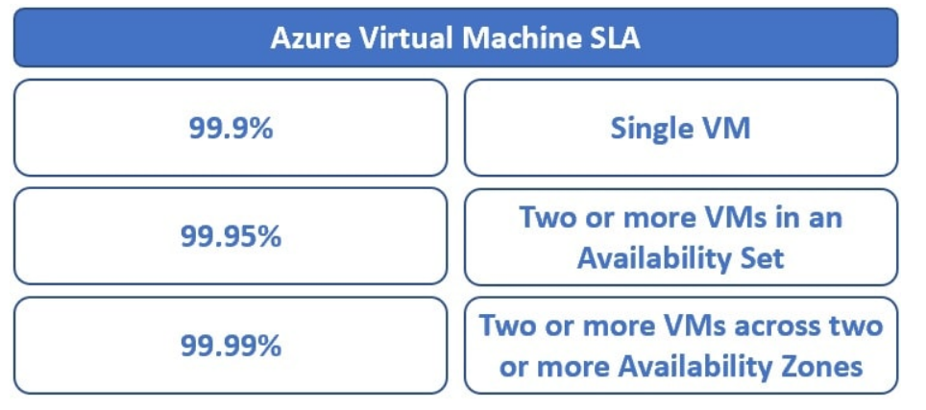
Azure VMs High availability
Availability sets
An Availability Set is a logical grouping for isolating virtual machine resources from each other.
Azure makes sure that the VMs we place in an Availability Set run across multiple physical servers, compute racks, storage units, and network switches
Availability Zones
Group of two or more azure datacentres in a region to provide redundancy and high availability

Slide 15
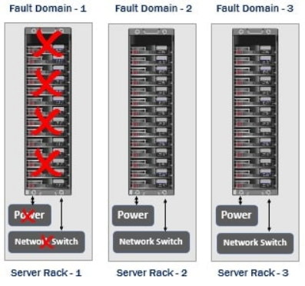
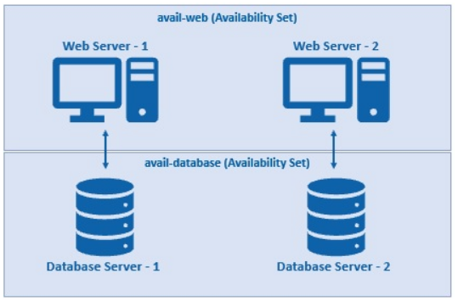
Azure Availability set
VMs should be deployed in Same region, vnet and resource group
Minimum 2 VMs should deploy to get benefit from Availability sets
SLA 99.95%

Slide 16
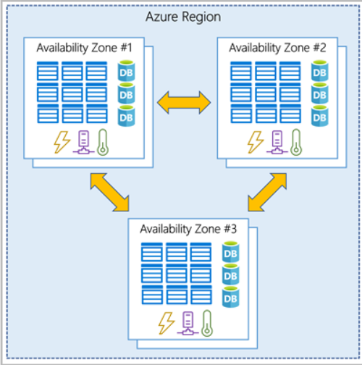
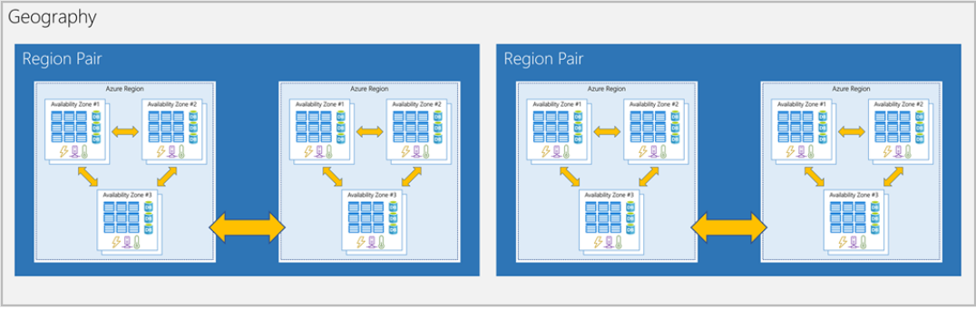
Azure Availability Zones
Disaster Recovery and Business Continuity scenario
SLA 99.99%

Slide 17
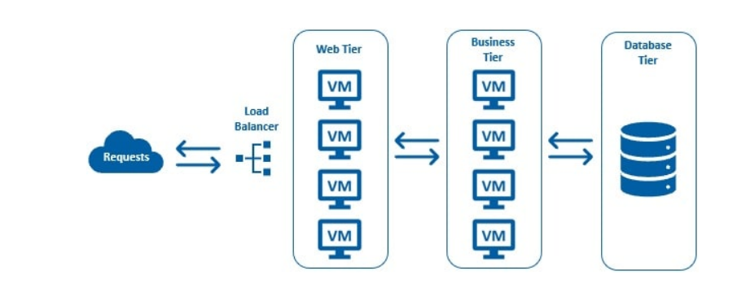
Azure VM Scale Sets
A Virtual Machine Scale Set lets us easily create and manage multiple virtual machines.
All VMs in a scale set are identical, meaning they are created from the same base operating system image and configuration.
Obviously, this approach lets us easily manage hundreds of VMs without additional configuration.
For traffic distribution, an Azure Load Balancer is also deployed along with the virtual machines in a scale set.
There is no need to manually create the virtual machines or the load balancer. Just imagine the amount of time it saves.

Slide 18
Any Questions?

Slide 19
Thank you…!!!

